Slide 1
Climate Change
Name
Institution
Date

Slide 2
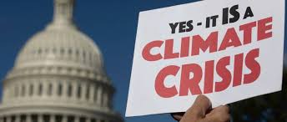
Introduction
The global issue I am addressing is climate change
Climate change includes global warming and changes in weather patterns
Human activities have immensely contributed to the climate change crisis
This crisis needs to be addressed to promote economic growth and a healthy environment (Ahmed 180).
Notes:
The global issue that I would like to address is climate change. Climate change includes global warming and the drastic change of weather patterns across the globe. The increase of greenhouse gases in the atmosphere contributing to global warming is attributed to human activities, with the main contributor being fossil fuel energy use (Ahmed 180). The devastating effects of climate change are evident as flood, desertification, storms, heat waves, intense droughts, melting glaciers, among others. This crisis needs to be addressed to promote global economic growth, sustainable development, and a healthier global environment. This proposal presents my plan in contributions to climate change mitigation action. There are many solutions that can be adopted to reduce climate change globally. Individual contributions are, however, required to push the main agenda forward. In the proposal, I have included these solutions and how we can execute them for the common good. I have also included the projected timeline of each solution and the sources of my proposed solutions.

Slide 3
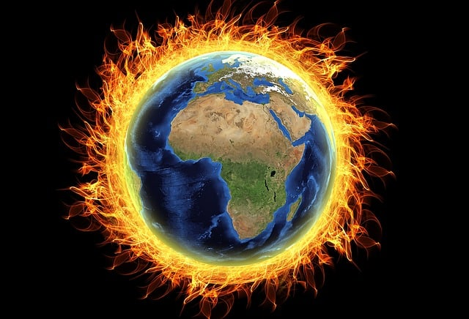
Problems
Climate change has resulted in increased temperatures
Human activities like the cutting of trees have caused global warming
Global warming threatens the health, agriculture and causes water shortage
Addressing climate change would help protect biodiversity, human life, and oceans (Pecl et al., 115).
Notes:
Climate change is a global health issue that needs to be addressed to prevent the resulting adverse effects. The changes in climate have resulted in dire consequences, such as increased temperatures, which have resulted in extreme weather, breaking of ice chunks in the Antarctic, and an increase in wildfires (Pecl et al., 115). Human beings are the major contributors to climate change through cutting down trees and burning fossil fuels. These activities increase global warming that increases the risk of agricultural activities, supply of water, and health. The change in climate causes a subsequent change in biodiversity that negatively affects human life. Biodiversity supports the ecosystem and thus offers the justification for interventions to minimize the adverse consequences of climate change. In addition, climate change needs to be addressed to protect the oceans. Essentially, the oceans are involved in climate regulation and capturing a more significant percentage of carbon emissions.

Slide 4

Objective
To suggest possible solutions for addressing climate change
To create awareness on the dangers of climate change
To educate people on personal responsibility to address climate change
Governments and the citizenry should collaborate in solving climate change
Notes:
The objective of this proposal is to offer suggestions pertaining to the possible solutions in addressing the issue of climate change. The primary objective of this research is to create awareness of the dangers of climate change and educate people on how they can take personal responsibility in the prevention and management of climate change. If people are aware of how climate change affects them and then informed on how they can prevent and manage climate change, this issue would not be categorized as a global issue. The prevention of climate change is not the responsibility of the government only. Instead, it is the responsibility of both the government and citizens. Therefore, if people take responsibility for climate change, this would encourage leaders from different parts of the globe to pass bills as well as regulations that aid in the prevention and management of climate change.

Slide 5
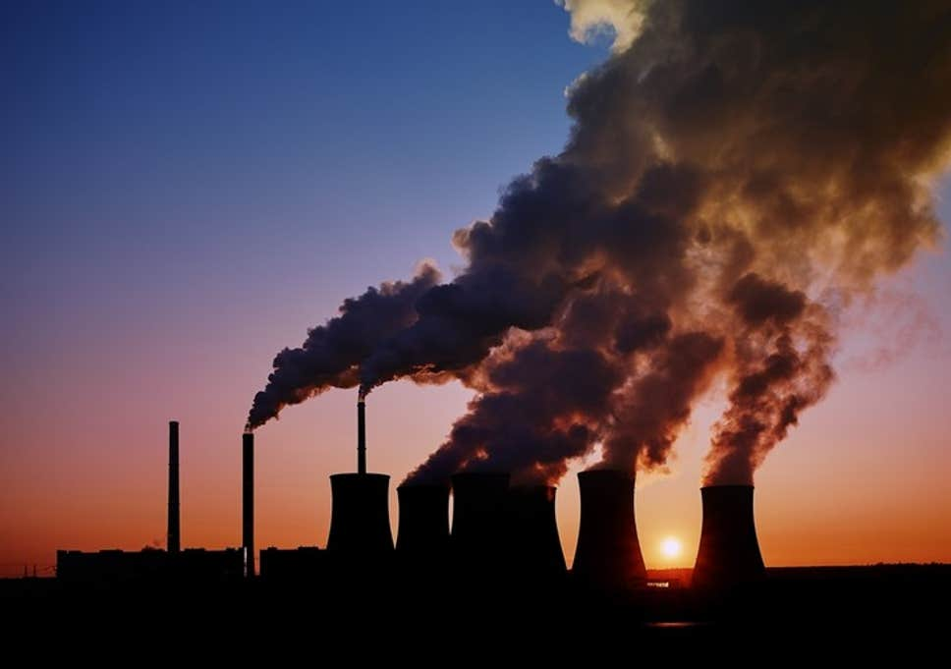
Background
The concentration of greenhouse gases in the atmosphere causes global warming.
Human activities majorly cause global warming
Global warmth has been increasing
Climate change increases natural disasters (Al‐Ghussain 20).
Notes:
Global warming is a facet of climate change associated with a long-term increase in temperature (Masson-Delmotte et al., 8). Global warming occurs when a more significant percentage of greenhouse gases concentrate in the atmosphere due to the rise in human activities like the burning of fossil fuels and deforestation. Fossil fuels include coal and gas, and when people burn them, they release carbon dioxide that pollutes the atmosphere. Deforestation has also increased global warming. Climate change is a serious issue affecting a significant number of people globally. The change in climate affects the social as well as the environmental health determinants like adequate food, safe water for drinking, clean air, and safe shelter. Over the previous 130 years, there has been an increase in global warmth by probably 0.85 degrees Celsius, and all of the previous 3 decades have been progressively becoming warmer than the previous decades (Kweku et al., 7). The change in climate causes extreme heat and natural disasters. Since the 1960s, the number of natural disasters associated with changes in climate has tripled. In developing countries, natural disasters caused by climate change result in the death of around 60 000 people (Al‐Ghussain 20).

Slide 6
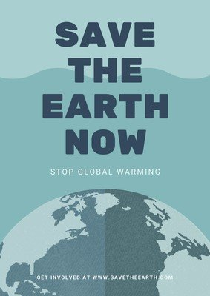
Solution
Addressing climate change would protect human life and the universe
People should prepare and adapt to climate change
Countries should plan how to manage water scarcity
Investments should be socially just and scientifically fair (Mi 585).
Notes:
The prevention of climate change is imperative in order to protect both the universe and human life. In order to prevent climate change, people need to be fully prepared and adapt. Despite the quickness in which people can minimize emissions, it is a reality that some specific impacts of climate are inevitable. Notably, the seas are always rising, and temperatures are extremely becoming hot each year. Also, drought and floods are negatively affecting communities. Therefore, in the short-term prevention of climate change, people need to adapt. This implies that human beings should discourage the development of infrastructure in high-risk places, countries should effectively plan how to manage the scarcity of water, and the government, organizations, and individuals should focus on developing more environmentally friendly cities as well as communities (Mi 585). All investments should be socially just and scientifically fair and result in more significant consequences, especially to communities with low income and minority communities.

Slide 7
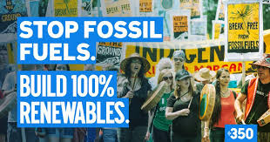
Solution Continued
Reduction of harmful emissions into the atmosphere
Effective land management practices and the use of carbon machines
Managing and recycling waste
Embrace renewable energy sources (Favretto et al., 779).
Notes:
One of the long-term solutions to climate change is the reduction of harmful emissions into the atmosphere. For human beings to shun the severe impacts of climate change, they will need to attain zero carbon dioxide emission by the year 2050 or even before (Leifeld & Menichetti 5). For people to attain zero emission, they need to transform their production and consumption of electricity enormously. Besides, effective land management practices and the use of machines that capture carbon dioxide directly from the air can be helpful in the reduction of the release of harmful emissions into the atmosphere. The Intergovernmental Panel on Climate Change hints that enhanced practices in agriculture as well as land management, such as improved management of land used for crops and grazing, resorting peaty soils and degraded land, could minimize the emission of greenhouse gases by 265 metric tons of carbon dioxide each year by the year 2030, especially in sub-Saharan Africa (Favretto et al., 779). The use of direct air capture machines that suck carbon dioxide directly from the atmosphere could reduce the cost of attaining international climate goals. Moreover, there is a need to embrace renewable energy sources, such as wind and solar. These sources have significantly low emissions into the environment, and they are perceived to be environmentally friendly.

Slide 8
Schedule
In the next three months, start an awareness campaign
Seek partnerships from both government and private agencies
Launch an open day for tree planting towards the end of the year
Notes:
A timeline of events is also essential in the execution of the developed proposal. For example, in the next three months, there should be a launch of an awareness campaign in order to sensitize the public on the dangers of the continued climate change and some of the interventions that people can resolve in order to solve the current climate change crisis. Addressing the crisis of climate change also requires collaboration and partnership from the government and private sectors. Therefore, next on the schedule list would be seeking partnerships from government agencies and the private sector. There will also be a launch of an open day for planting trees towards the end of the year. The regular planting of trees is one of the most effective interventions for addressing the climate change crisis since it would significantly reduce global warming and water shortage.

Slide 9
Budget
Item | Cost in US Dollars
Renewable energy | 10 trillion
Electric vehicles | 10 trillion
Machines for capturing carbon dioxide | 2.5 trillion
Hydrogen | 18 trillion
Biofuel | 2.5 trillion
Total | 43 trillion
.
Notes:
Solving the global issue of climate change may cost a considerable amount of money. For example, money is needed to educate the public on the need for climate change prevention, buying machines that capture carbon dioxide and energy costs for these machines, waste recycling, and use of renewable sources of energy. Implementing the identified solutions will be a long-term plan, and its actual and full benefits may be realized by the year 2050. This budget is a global one for solving a global problem. Globally, renewable energy sources may cost around 10 trillion. The use of electric vehicles to replace the current ones that use fuel may also cost around 10 trillion. The use of machines that capture carbon dioxide may cost 2.5 trillion. Hydrogen, which may also be a reliable future source of power, may cost around 18 trillion. Besides, biofuel, such as ethanol that will be used for future international transportation and that will be extended to aircraft, may cost around 2.5 trillion. Therefore below is a budget estimate to solve the climate change issue by the year 2050.

Slide 10
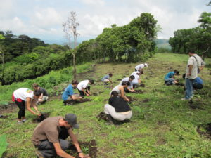
Recommendations
People and businesses should reduce the emission of harmful gases
People should increase the practices of afforestation and reforestation
Regular use of renewable sources of energy
Adopt effective land management and agricultural practices (Favretto et al., 779).
Notes:
Preventing climate change is essential in the achievement of a sustainable and healthy environment free of health conditions and fit for both animal and human living. Therefore, it is recommended that both people and business organizations reduce the emission of harmful gases into the atmosphere. This would be beneficial in preventing global warming and its adverse effects on human beings. It is also recommended that people increase the practices of afforestation and reforestation and shun deforestation in order to conserve the environment. It is further recommended that people and agricultural organizations adopt effective land management and agricultural practices in order to conserve soil erosion and reduce the emission of greenhouse gases into the environment (Favretto et al., 779). Governments from all over the world should also consider using machines that capture carbon dioxide directly from the atmosphere in order to minimize the cost of global warming. In addition, it is recommended that governments, business organizations, and people adopt the use of renewable sources of energy. Renewable sources of energy such as solar and wind are readily available, inexhaustible, cost-effective, and result in fewer negative impacts to the environment.

Slide 11
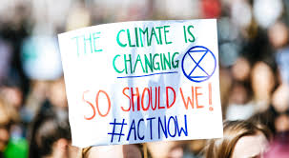
Conclusion
Climate change affects human beings, animals, and governments
Climate change causes global warming
Causes of climate change include the use of non-renewable energy sources and deforestation.
Solving climate change requires effort from people, government, and private agencies.
Notes:
In summation, climate change has become a significant global issue of great concern. Climate change affects governments, human beings, and animals. Climate change causes global warming, which threatens ecosystems through extremely high temperatures, increased wildfires, drought, and shortage of water. Some of the primary causes of climate change include the increased human reliance on fossil fuels, deforestation, and adoption of extensive agriculture, which leads to the increased emission of greenhouse gases into the atmosphere. In addition, the lack of strict policy implementation has increased the release of harmful gases into the atmosphere and non-biodegradable waste products into the environment. Some of the solutions to climate change include the reduction of harmful emissions into the atmosphere, effective land management practices, and the use of machines that capture carbon dioxide directly from the air, a need to embrace renewable energy sources, adopting a sustainable transportation system, preventing air pollution, managing and recycling waste, preserving water bodies like seas and oceans, and striving for a circular economy.

Slide 12
Sources
Ahmed, Mukhtar. "Introduction to Modern Climate Change.Andrew E. Dessler: Cambridge University Press, 2011, 252 pp, ISBN-10: 0521173159." The Science of the Total Environment 734 (2020): 139-397.
Al‐Ghussain, Loiy. "Global warming: review on driving forces and mitigation." Environmental Progress & Sustainable Energy 38.1 (2019): 13-21.
Ballew, Matthew T., et al. "Climate change in the American mind: Data, tools, and trends." Environment: Science and Policy for Sustainable Development 61.3 (2019): 4-18.
Environment Defense Fund. This is why fighting climate change is so urgent. (2021):2-3. Retrieved from https://www.edf.org/climate/why-fighting-climate-change-so-urgent
Favretto, Nicola, et al. "Links between climate change mitigation, adaptation and development in land policy and ecosystem restoration projects: Lessons from South Africa." Sustainability 10.3 (2018): 779.

Slide 13
Sources
Kweku, Darkwah Williams, et al. "Greenhouse effect: greenhouse gases and their impact on global warming." Journal of Scientific research and reports (2017): 1-9.
Leifeld, J., and L. Menichetti. "The underappreciated potential of peatlands in global climate change mitigation strategies." Nature communications 9.1 (2018): 1-7.
Masson-Delmotte, Valérie, et al. "Global warming of 1.5 C." An IPCC Special Report on the impacts of global warming of 1 (2018): 1-9.
Mi, Zhifu, et al. "Cities: The core of climate change mitigation." Journal of Cleaner Production 207 (2019): 582-589.
Pecl, Gretta T., et al. "Biodiversity redistribution under climate change: Impacts on ecosystems and human well-being." Science 355.6332 (2017): 99-182.
Röck, Martin, et al. "Embodied GHG emissions of buildings–The hidden challenge for effective climate change mitigation." Applied Energy 258 (2020):107-114.

